Slide 1

SIMATS ENGINEERING
CSA-0827:PYTHON PROGRAMMING IN NUMERICAL COMPUTATIONS
PROJECT TITLE: COUNTDOWN CLOCK AND TIMER USING PYTHON
Under the guidance of
S. Raveena
(Research Scholar, Department of Cognitive computing)
Presented by:
Nikhil
192211031
Sayed Tausif 192021017
Vineesha
192220064

Slide 2
AGENDA
INTRODUCTION
ABSTRACT
LITERATURE SURVEY
PROPOSED OBJECTIVE
PROPOSED STATEMENT
HARDWARE AND SOFTWARE
DESIGN
IMPLIMENTATION AND OUTPUT CODES
CONCLUSION

Slide 3
INTRODUCTION:-
Describe countdown clocks and timers as electrical devices that indicate and measure the amount of time left before a deadline or event.
Emphasize how crucial timers and countdown clocks are for helping people and organizations stay organized, manage their time well, and achieve deadlines.
Talk about Python as a well-liked programming language that is great for creating countdown clocks and timers because of its ease of use, adaptability, and large library.
Highlight Python's user-friendliness, which enables both novice and seasoned developers to create countdown clock applications with ease.
Describe how the flexibility of Python enables developers to alter the look and feel of countdown clock and timer applications, as well as specify countdown lengths and alert sound preferences.

Slide 4
ABSTRACT:-
Provide a brief overview of countdown clocks and timers as essential tools for time management and deadline tracking.
Describe the basic characteristics and functions of the countdown clock and timer application, such as how to establish countdown lengths, see how much time is left, and send out warnings.
Emphasize that Python was selected as the preferred programming language because of its ease of use, adaptability, and large library for creating the countdown clock application.
Explain how the built-in modules and external libraries for Python were used in the design and implementation of the countdown clock and timer application.
Talk about how the countdown clock application's flexibility lets users change things like countdown formats, alarm noises, and visual themes.
Examine the possibilities for combining the countdown clock application with other platforms and technologies, including desktop programs, web apps, and Internet of things gadgets.

Slide 5
Literature Survey:-
Discover the development of countdown clocks and timers over time, from mechanical to digital and software-based gadgets.
Emphasize significant turning points, innovations, and technological advances in countdown timers.
Examine the various uses and applications of countdown clocks and timers in a variety of contexts, such as industrial processes, scientific investigations, sports, cookery, event planning, and personal productivity.
Examine the basic ideas and technologies of countdown clock and timer systems, including hardware, software, and user interfaces, as well as timekeeping techniques.
Examine studies on user experience and design approaches for timer and countdown clock applications.
Look at the best practices for visual design, interaction design, accessibility features, and interface design

Slide 6
PROPOSED OBJECTIVE:-
Time Management
Games And Challenges
Remainder System
Event Synchronization
Presentation Timing
Efficiency Improvement

Slide 7
PROPOSED STATEMENT:-
Customizable Time Management
Visual and Auditory Alerts
Task Integration
Cross platform Accessibility

Slide 8
HARDWARE AND SOFTWARE:-
Hardware:
Laptop
Software:
Windows 10
Intel i5
IDLE

Slide 9
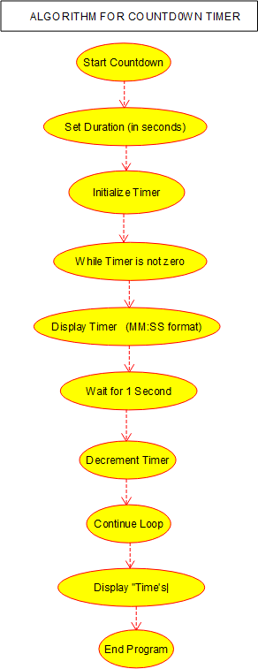
DESIGN:-

Slide 10
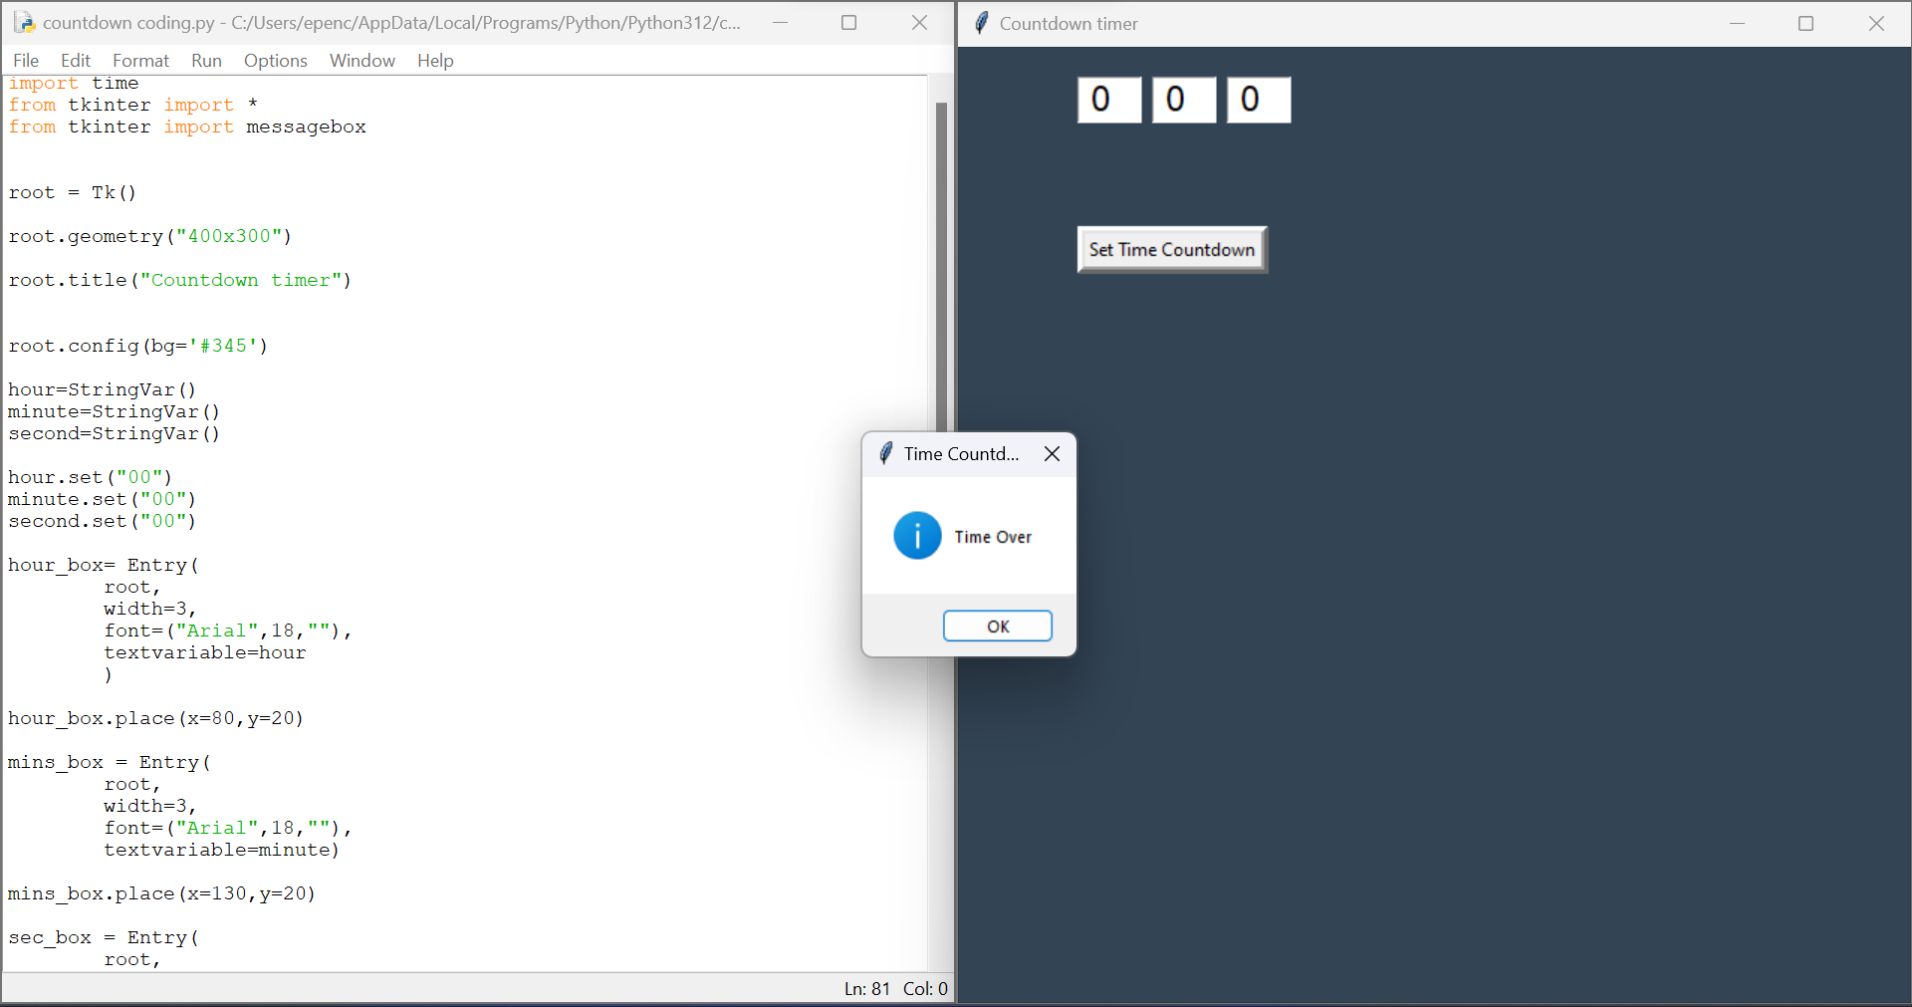
IMPLEMENTATION&OUTPUT CODES:-

Slide 11
CONCLUSION:-
▶ The countdown timer is a simple yet effective tool that serves various purposes in different contexts. Whether used in presentations, events, or daily activities, a countdown timer adds a sense of urgency, organization, and engagement. Key takeaways from the presentation on countdown timers .

Slide 12
REFERENCES:-
Campbell, G. K. et al. The absolute frequency of the 87Sr optical clock transition. Metrologia 45, 539 (2008).
Bothwell, T. et al. Resolving the gravitational redshift within a millimeter atomic sample. Nature https://doi.org/10.1038/s41586-021-04349-7 (2022).
Boulder Atomic Clock Optical Network (BACON) Collaboration. Frequency ratio measurements at 18-digit accuracy using an optical clock network. Nature 591, 564–569 (2021).
Li C, Li Z, Li T, Li C and Wang B. A Deterministic Embedded End-System Tightly Coupled With TSN Schedule. IEEE Transactions on Computer-Aided Design of Integrated Circuits and Systems. 10.1109/TCAD.2023.3248500. 42:11. (37073719)
E.Lagnf F and Ganesan S. (2022). The Improved Implementation of the Message freshness on CAN XL using FPGA 2022 IEEE International Conference on Electro Information Technology (eIT). 10.1109/eIT53891.2022.9813763. 978-1-6654-8009-3. (215-220).

Slide 13


